Slide 1

A wind tunnel for kids…
Status Update
October 20, 2011

Slide 2
Activities this week
ROM Draft
SRS Draft
Technical Risk Reduction
Physical Wind Tunnel controls and instrumentation prototyping
Android NDK Prototyping

Slide 3
Sources of Technical Risk
Physical Tunnel
Virtual Tunnel
Existing Fan
RPM measurement
Control
Arduino-Arduino communication
Ethernet Communication
Android-Arduino communication
Model Positioning System?
“Nice to have,” but may be difficult to fabricate
“Whiteboard”
Translating user-drawn shape into computational grid
Existing Flow Solver Code
Porting to Android using the Native Development Kit (NDK)
Speed and stability issues?
Translating solver output to lift and drag info
Translating Solver Output To Pretty Picture
Notes:
Somewhat of a repeat of last week. May continue to brief this slide to track prototyping progress.

Slide 4
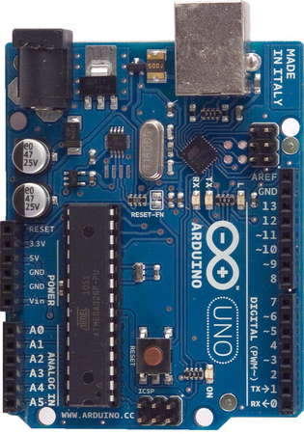
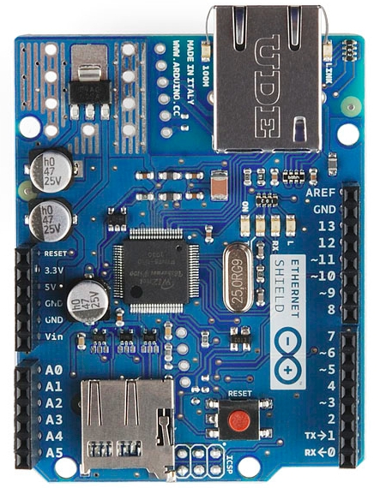
Arduino and Ethernet Shield
Notes:
Arduino components being used. Note the size of the I/O blocks

Slide 5
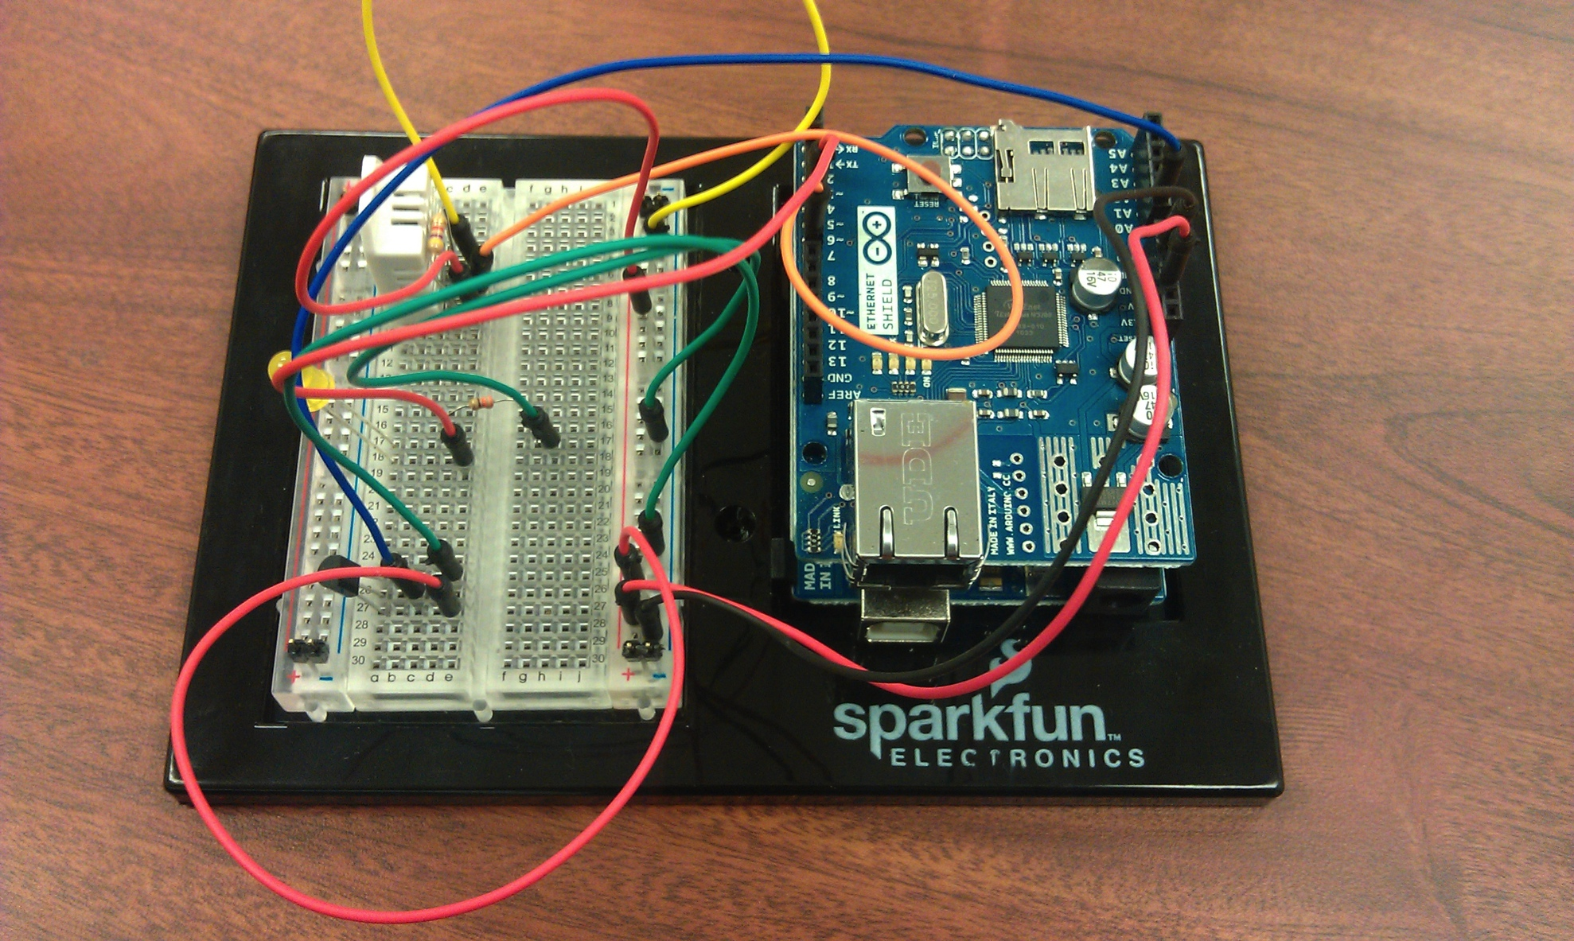
Temperature and Humidity Sensors
Humidity and Temperature Sensor
Measurements shared via Ethernet
Temperature Sensor (IC)
Notes:
Chris’ prototype of basic sensors and network communication. Measurements sent to Twitter.

Slide 6
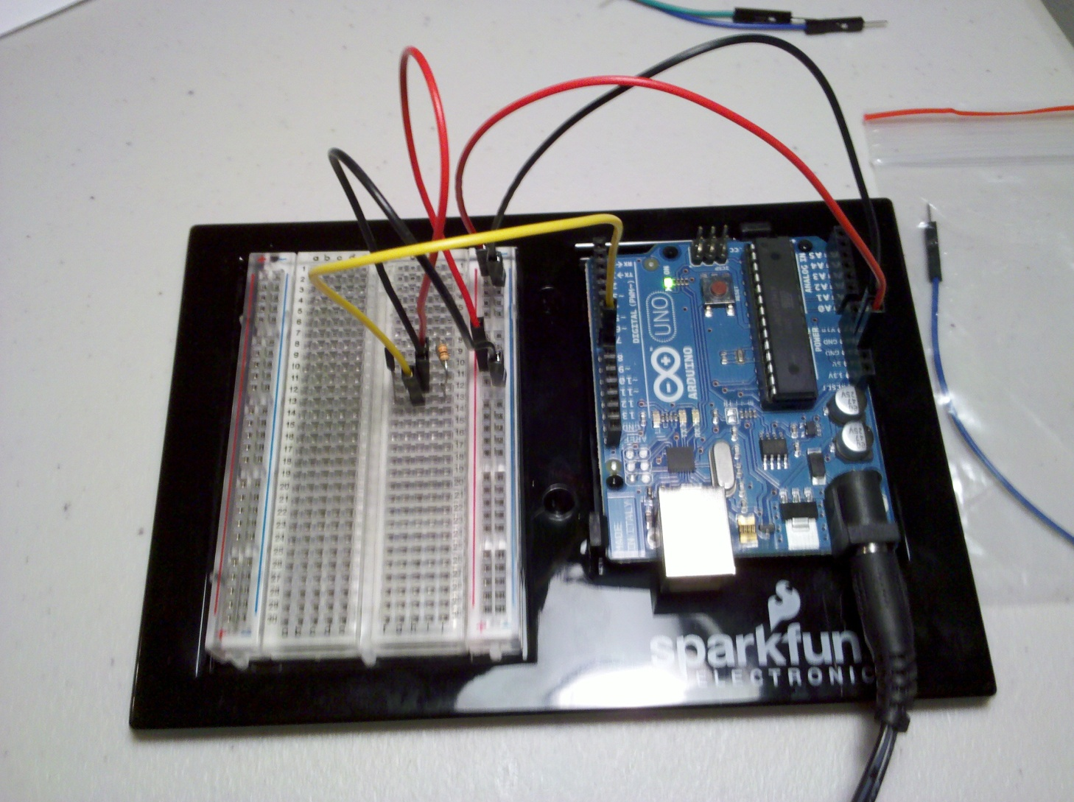
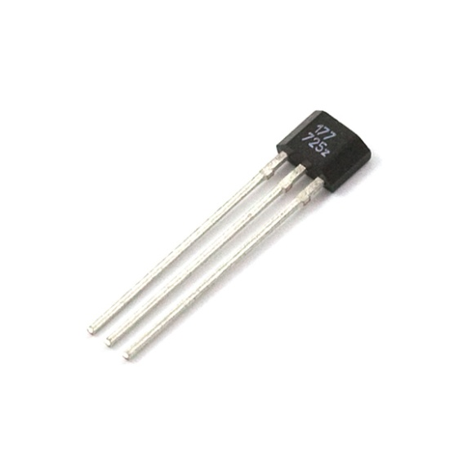
Hall Effect Sensor
Hall Effect Sensor
LED Blinks when magnetic field is sensed
Notes:
Michael’s prototype of hall effect sensor. It is believed that fan RPM can be effectively and cheaply measured using this sensor. Next step is to attach magnets to a fan, attach the sensor on to some sort of probe, and write code to handle interrupts caused by the sensor going high.

Slide 7

Android NDK
Downloaded the NDK
Building samples and experimenting before attempting to build 2D flow solver code
Concerned about use of the STL

Slide 8
Workload
 | Requirements | ROM | Prototyping | Total
Josh Calahan | 5 |  | 4 | 9
Wes Cothran |  | 11 |  | 11
Chris Davis | 3 |  | 6 | 10
Michael Lynch | 3 |  | 6 | 9
Brian Pittman | 7 | 2 |  | 9
Totals | 18 | 13 | 16 | 48

Slide 9

Follow us on Twitter… 4 followers – 47 tweets
@TunnelK
Notes:
Initial social network of choice…

